Slide 1
SQL Server runs best on Azure

Slide 2






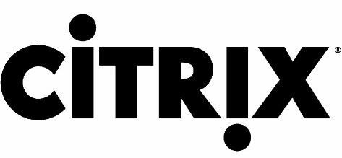





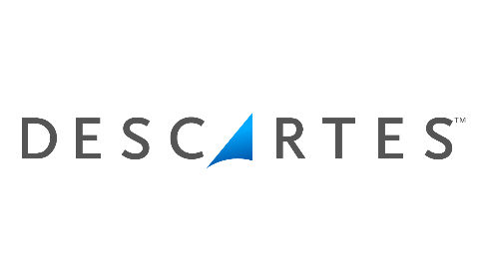




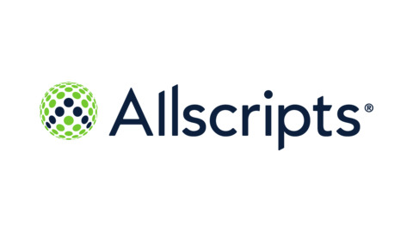

Customer momentum
6.4+ million
database instances in Azure SQL
9 trillion
queries per day in Azure SQL
Best price-performance costing up to
87%
less than the competition
>30%
serverless customers new to Azure SQL Database

Slide 3



Azure SQL
A unified SQL portfolio built on the industry-leading SQL Server engine
Service
SQL Server on Azure Virtual Machines
Best for re-hosting and apps requiring OS-level access and control
Azure SQL Managed Instance
Best for modernizing existing apps
Azure SQL Database
Best for building new apps in the cloud
Resource model
Virtual machine
Automated manageability features and OS-level access
Instance
Offers high compatibility with SQL Server and native VNET support
Database
Pre-provisioned or serverless compute and Hyperscale storage to meet demanding workload requirements
Notes:
Azure SQL is a modern portfolio with a strong track record of innovation, powered by the industry-leading SQL Server engine that has evolved and perfected over 25 years. The Azure SQL portfolio provides you with the flexibility to create and manage SQL Server-based apps on virtual machines or fully-managed databases in the cloud or at the edge, using a single, unified experience.

Slide 4




Azure SQL is the best choice for SQL Server workloads
SQL consistency, from edge to cloud
Real-time threat protection and security management
Best total cost of ownership
Managed on your behalf
Build on a common SQL Server code base that is consistent across the edge, your datacenter and Azure
Secure your data with layers of protection, built-in controls and intelligent threat detection
Meet mission-critical requirements up to 3.6 times faster and up to 87 percent less expensive than AWS.
Azure SQL is evergreen, with software and infrastructure continually updated for you

Slide 5

Introducing the GigaOm performance studies
GigaOm, an independent research firm, published studies in which they tested throughput performance for:
Azure SQL Database vs. Amazon RDS for SQL Server
SQL Server on Azure Virtual Machines vs. SQL Server on AWS EC2
Performance is derived from the TPC-E transaction per second (TPS) metric. The database benchmark TPC-E was developed and published by the Transaction Processing Performance Council (TPC). The TPC-E benchmark measures the performance of online transaction processing systems (OLTP).

Slide 6
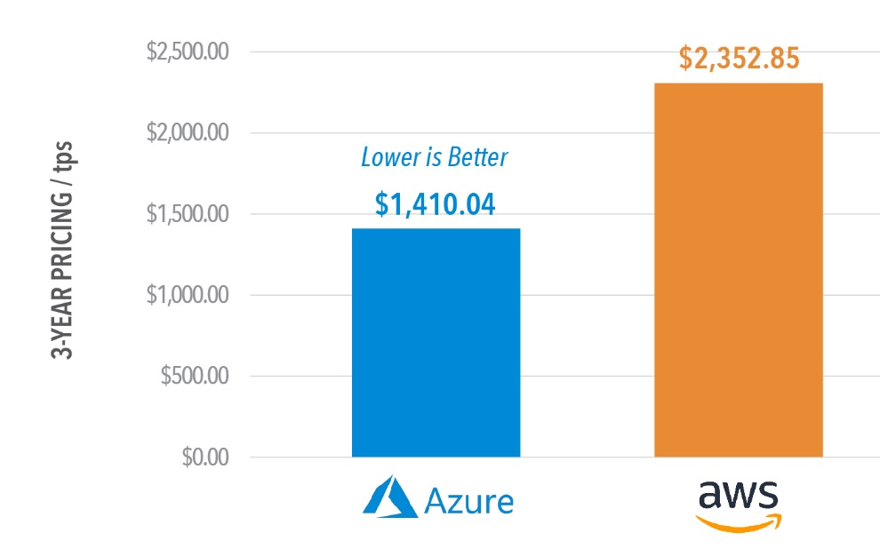
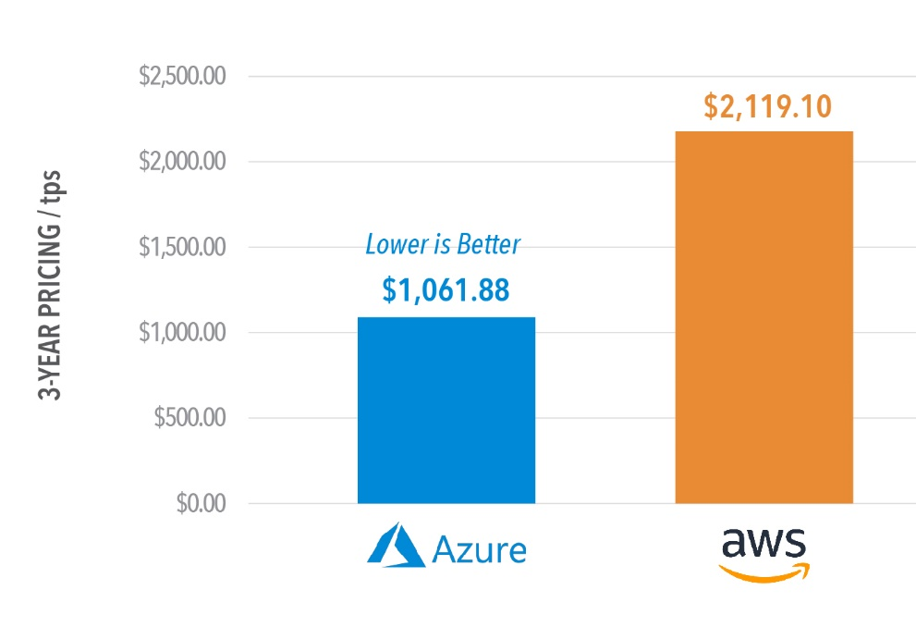
Benchmarks show Azure SQL Database delivers up to 86% savings
Azure SQL Database vs. Amazon RDS for SQL Server price-performance comparison
License Included vs License Included
3 yr RI vs 3 yr RI
40% less
50% less
Data sets derived from industry-recognized TPC-E Benchmark™
Simulated 600 concurrent users, unlimited pacing, 8 deg of parallelism, 5 test runs.
Tested “nearest best fit” SKUs optimized for memory-intensive, latency sensitive workloads.
Recent testing indicates path to similar or better price-perf results at lower, 4 vCore options – stay tuned.
Price-performance claim based on data from a study commissioned by Microsoft and conducted by GigaOm in August 2019. The study compared price performance between a single, 80 vCore, Gen 5 Azure SQL Database on the business-critical service tier and the db.r4.16xlarge offering for SQL Server on AWS RDS. Benchmark data is taken from a GigaOm Analytic Field Test derived from a recognized industry standard, TPC Benchmark™ E (TPC-E), and is based on a mixture of read-only and update intensive transactions that simulate activities found in complex OLTP application environments. Price-performance is calculated by GigaOm as the cost of running the cloud platform continuously for three years divided by transactions per second throughput. Prices are based on publicly available US pricing in East US for Azure SQL Database and US East (Ohio) for AWS RDS as of August 2019. Price-performance results are based upon the configurations detailed in the GigaOm Analytic Field Test. Actual results and prices may vary based on configuration and region.

Slide 7
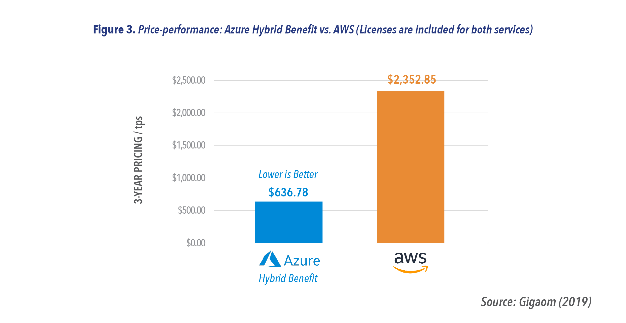
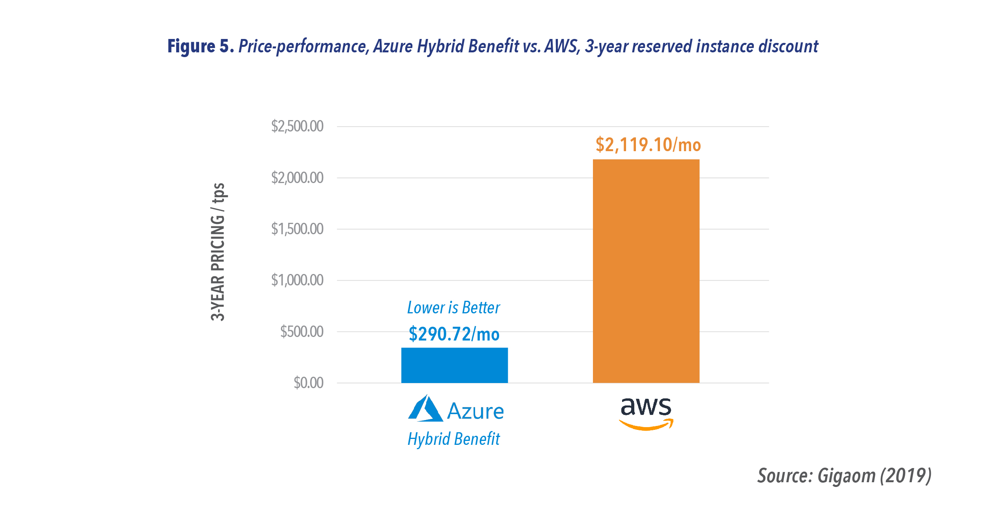
Benchmarks show Azure SQL Database delivers up to 86% savings
Azure SQL Database vs. Amazon RDS for SQL Server price-performance comparison
License Included vs License Included
3 yr RI vs 3 yr RI
AWS License Included vs AHB
AWS 3 yr RI vs AHB + 3 yr RI
40% less
50% less
73% less
86% less
Price-perf optimized with unique hybrid benefit
Data sets derived from industry-recognized TPC-E Benchmark™
Simulated 600 concurrent users, unlimited pacing, 8 deg of parallelism, 5 test runs.
Tested “nearest best fit” SKUs optimized for memory-intensive, latency sensitive workloads.
Recent testing indicates path to similar or better price-perf results at lower, 4 vCore options – stay tuned.
Price-performance claim based on data from a study commissioned by Microsoft and conducted by GigaOm in August 2019. The study compared price performance between a single, 80 vCore, Gen 5 Azure SQL Database on the business-critical service tier and the db.r4.16xlarge offering for SQL Server on AWS RDS. Benchmark data is taken from a GigaOm Analytic Field Test derived from a recognized industry standard, TPC Benchmark™ E (TPC-E), and is based on a mixture of read-only and update intensive transactions that simulate activities found in complex OLTP application environments. Price-performance is calculated by GigaOm as the cost of running the cloud platform continuously for three years divided by transactions per second throughput. Prices are based on publicly available US pricing in East US for Azure SQL Database and US East (Ohio) for AWS RDS as of August 2019. Price-performance results are based upon the configurations detailed in the GigaOm Analytic Field Test. Actual results and prices may vary based on configuration and region.

Slide 8
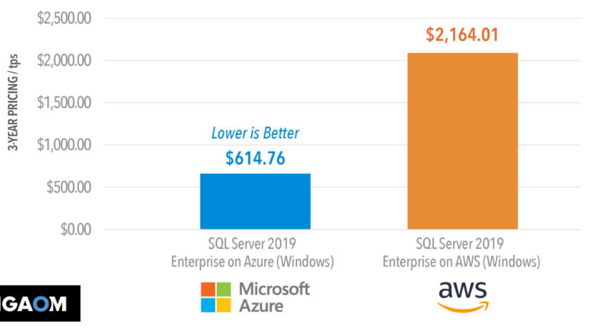
Benchmarks show Azure SQL VMs deliver up to 84% savings
2nd SQL IaaS Benchmark Report (February 2020)*
SQL Server on Azure Virtual Machines vs. SQL Server on AWS EC2 price-performance comparison
License Included vs License Included
72% less
Data sets derived from industry-recognized TPC-E Benchmark™
Simulated 400 concurrent users, unlimited pacing, 8 deg of parallelism, 5 test runs.
Results above were for the latest AMD VM series on Azure and AWS.
*See appendix for results from initial study
Price-performance claims based on data from a study commissioned by Microsoft and conducted by GigaOm in February 2020. The study compared price performance between SQL Server 2019 Enterprise Edition on Windows Server 2019 Datacenter edition in Azure E32as_v4 instance type with P30 Premium SSD Disks and the SQL Server 2019 Enterprise Edition on Windows Server 2019 Datacenter edition in AWS EC2 r5a.8xlarge instance type with General Purpose (gp2) volumes. Benchmark data is taken from a GigaOm Analytic Field Test derived from a recognized industry standard, TPC Benchmark™ E (TPC-E). The Field Test does not implement the full TPC-E benchmark and as such is not comparable to any published TPC-E benchmarks. Prices are based on publicly available US pricing in West US for SQL Server on Azure Virtual Machines and Northern California for AWS EC2 as of January 2020. The pricing incorporates three-year reservations for Azure and AWS compute pricing, and Azure Hybrid Benefit for SQL Server and Azure Hybrid Benefit for Windows Server and License Mobility for SQL Server in AWS, excluding Software Assurance costs. Actual results and prices may vary based on configuration and region.

Slide 9
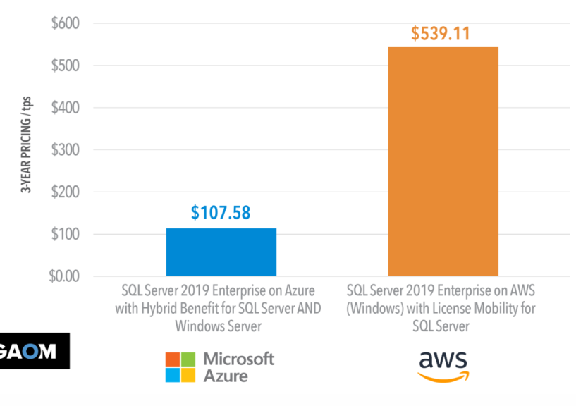
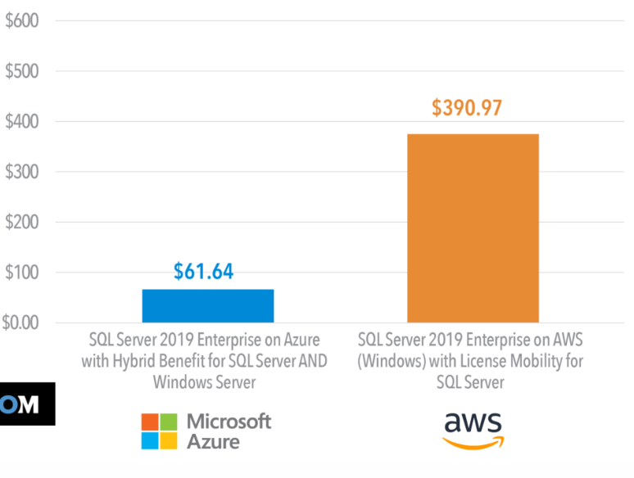
Benchmarks show Azure SQL VMs deliver up to 84% savings
2nd SQL IaaS Benchmark Report (February 2020)*
SQL Server on Azure Virtual Machines vs. SQL Server on AWS EC2 price-performance comparison
License Included vs License Included
AWS License Included vs AHB
AWS 3 yr RI vs AHB + 3 yr RI
72% less
80% less
84% less
Price-perf optimized with unique hybrid benefit
Data sets derived from industry-recognized TPC-E Benchmark™
Simulated 400 concurrent users, unlimited pacing, 8 deg of parallelism, 5 test runs.
Results above were for the latest AMD VM series on Azure and AWS.
*See appendix for results from initial study
Price-performance claims based on data from a study commissioned by Microsoft and conducted by GigaOm in February 2020. The study compared price performance between SQL Server 2019 Enterprise Edition on Windows Server 2019 Datacenter edition in Azure E32as_v4 instance type with P30 Premium SSD Disks and the SQL Server 2019 Enterprise Edition on Windows Server 2019 Datacenter edition in AWS EC2 r5a.8xlarge instance type with General Purpose (gp2) volumes. Benchmark data is taken from a GigaOm Analytic Field Test derived from a recognized industry standard, TPC Benchmark™ E (TPC-E). The Field Test does not implement the full TPC-E benchmark and as such is not comparable to any published TPC-E benchmarks. Prices are based on publicly available US pricing in West US for SQL Server on Azure Virtual Machines and Northern California for AWS EC2 as of January 2020. The pricing incorporates three-year reservations for Azure and AWS compute pricing, and Azure Hybrid Benefit for SQL Server and Azure Hybrid Benefit for Windows Server and License Mobility for SQL Server in AWS, excluding Software Assurance costs. Actual results and prices may vary based on configuration and region.

Slide 10


Allscripts leveraged existing licensing to seamlessly migrate to the cloud with Azure Virtual Machines
Challenge
Solution
Outcome
Need to consolidate data after acquisitions
Migration of 600 SQL Server VMs to Azure with existing Windows and SQL Licenses
Licensing savings up to 82% with Azure Hybrid Benefit
“By moving our acquired applications to Azure, we were able to get them up, running, and adding value to the business in three weeks versus the three months needed to requisition servers and storage.”
Peter Tomlinson Director of IS, Technology Operations at Allscripts
Notes:
Customer story: https://customers.microsoft.com/en-us/story/allscripts-partner-professional-services-azure

Slide 11









More reasons to pick Azure over AWS for SQL Server workloads
Free support for SQL Server 2008/R2
Get free extended security updates for SQL Server 2008/R2 images in Azure IaaS for three years
Best total cost of ownership
Save up to 88% on Azure SQL Database compared to AWS RDS
Free Disaster Recovery secondary in Azure
On-premises SQL Server with Software Assurance now comes with free SQL license for Azure DR secondary
Evergreen SQL
Stay always up to date with Azure SQL Database, with full parity based on 100% code consistency
Automatic security updates
Ease of maintenance with automatic application of the latest security patches, only on Azure
Industry’s highest SLA on Azure SQL Database
Experience up to a 99.995% availability SLA and the industry’s first 100% business continuity SLA
Pre-configured cloud backup
Restore to a specific point in time with an automatically-generated Azure backup
ML-based performance and security
Optimize performance and security with built-in, ML-based features that act on your behalf
Only cloud with Developer edition
Access the fully-featured free SQL Server Developer edition, only pre-configured on Azure

Slide 13
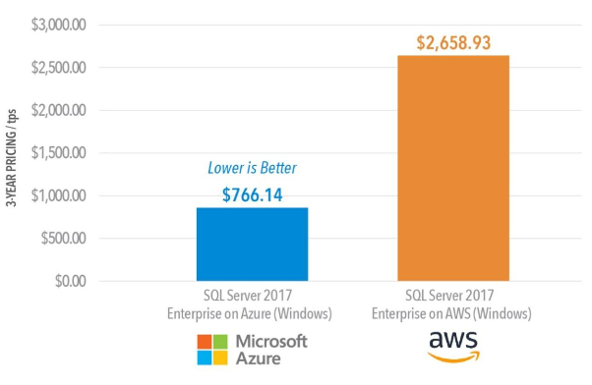
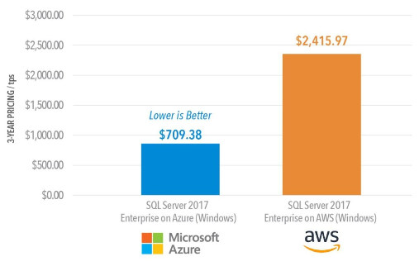
Benchmarks show Azure SQL VMs deliver up to 87% savings
1st SQL IaaS Benchmark Report (December 2019)
SQL Server on Azure Virtual Machines vs. SQL Server on AWS EC2 price-performance comparison
License Included vs License Included
3 yr RI vs 3 yr RI
71% less
71% less
Data sets derived from industry-recognized TPC-E Benchmark™
Simulated 400 concurrent users, unlimited pacing, 8 deg of parallelism, 5 test runs.
Results above were for Premium SSD storage on Windows Server. Similar tests run for Red Hat Enterprise Linux and for high-end storage.
Price-performance claims based on data from a study commissioned by Microsoft and conducted by GigaOm in October 2019. The study compared price performance between SQL Server 2017 Enterprise Edition on Windows Server 2016 Datacenter edition in Azure E64s_v3 instance type with 4x P30 1TB Storage Pool data (Read-Only Cache) + 1x P20 0.5TB log (No Cache) and the SQL Server 2017 Enterprise Edition on Windows Server 2016 Datacenter edition in AWS EC2 r4.16xlarge instance type with 1x 4TB gp2 data + 1x 1TB gp2 log. Benchmark data is taken from a GigaOm Analytic Field Test derived from a recognized industry standard, TPC Benchmark™ E (TPC-E). The Field Test does not implement the full TPC-E benchmark and as such is not comparable to any published TPC-E benchmarks. The Field Test is based on a mixture of read-only and update intensive transactions that simulate activities found in complex OLTP application environments. Price-performance is calculated by GigaOm as the cost of running the cloud platform continuously for three years divided by transactions per second throughput. Prices are based on publicly available US pricing in West US for SQL Server on Azure Virtual Machines and Northern California for AWS EC2 as of October 2019. The pricing incorporates three-year reservations for Azure and AWS compute pricing, and Azure Hybrid Benefit for SQL Server and Azure Hybrid Benefit for Windows Server and License Mobility for SQL Server in AWS, excluding Software Assurance costs. Price-performance results are based upon the configurations detailed in the GigaOm Analytic Field Test. Actual results and prices may vary based on configuration and region.

Slide 14
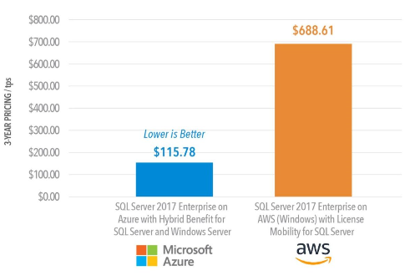
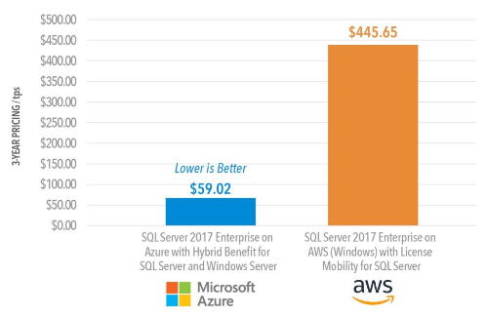
Benchmarks show Azure SQL VMs deliver up to 87% savings
1st SQL IaaS Benchmark Report (December 2019)
SQL Server on Azure Virtual Machines vs. SQL Server on AWS EC2 price-performance comparison
License Included vs License Included
3 yr RI vs 3 yr RI
AWS License Included vs AHB
AWS 3 yr RI vs AHB + 3 yr RI
71% less
71% less
83% less
87% less
Price-perf optimized with unique hybrid benefit
Data sets derived from industry-recognized TPC-E Benchmark™
Simulated 400 concurrent users, unlimited pacing, 8 deg of parallelism, 5 test runs.
Results above were for Premium SSD storage on Windows Server. Similar tests run for Red Hat Enterprise Linux and for high-end storage.
Price-performance claims based on data from a study commissioned by Microsoft and conducted by GigaOm in October 2019. The study compared price performance between SQL Server 2017 Enterprise Edition on Windows Server 2016 Datacenter edition in Azure E64s_v3 instance type with 4x P30 1TB Storage Pool data (Read-Only Cache) + 1x P20 0.5TB log (No Cache) and the SQL Server 2017 Enterprise Edition on Windows Server 2016 Datacenter edition in AWS EC2 r4.16xlarge instance type with 1x 4TB gp2 data + 1x 1TB gp2 log. Benchmark data is taken from a GigaOm Analytic Field Test derived from a recognized industry standard, TPC Benchmark™ E (TPC-E). The Field Test does not implement the full TPC-E benchmark and as such is not comparable to any published TPC-E benchmarks. The Field Test is based on a mixture of read-only and update intensive transactions that simulate activities found in complex OLTP application environments. Price-performance is calculated by GigaOm as the cost of running the cloud platform continuously for three years divided by transactions per second throughput. Prices are based on publicly available US pricing in West US for SQL Server on Azure Virtual Machines and Northern California for AWS EC2 as of October 2019. The pricing incorporates three-year reservations for Azure and AWS compute pricing, and Azure Hybrid Benefit for SQL Server and Azure Hybrid Benefit for Windows Server and License Mobility for SQL Server in AWS, excluding Software Assurance costs. Price-performance results are based upon the configurations detailed in the GigaOm Analytic Field Test. Actual results and prices may vary based on configuration and region.

Slide 15
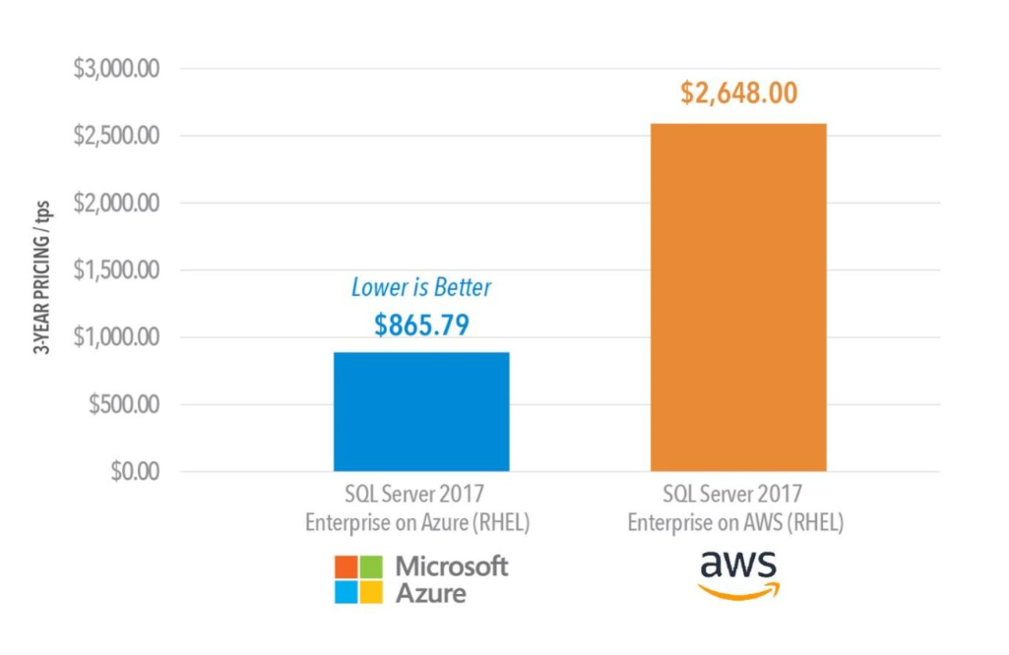
Benchmarks show Azure SQL VMs on Linux deliver up to 67% savings
1st SQL IaaS Benchmark Report (December 2019)
Azure vs. AWS on Linux, pay-as-you-go price-performance comparison
67% less
Data sets derived from industry-recognized TPC-E Benchmark™
Simulated 400 concurrent users, unlimited pacing, 8 deg of parallelism, 5 test runs.
Results above were for the latest AMD VM series on Azure and AWS.
Performance and price-performance claims based on data from a study commissioned by Microsoft and conducted by GigaOm in October 2019. The study compared price performance between SQL Server 2017 Enterprise edition on Red Hat Enterprise Linux 7.4 in Azure E64s_v3 instance type with 4x P30 1TB Storage Pool data (Read Only Cache) + 1x P20 0.5TB log (No Cache) and the SQL Server 2017 Enterprise edition on Red Hat Enterprise Linux 7.4 in AWS EC2 r4.16xlarge instance type with 1x 4TB gp2 data + 1x 1TB gp2 log. Benchmark data is taken from a GigaOm Analytic Field Test derived from a recognized industry standard, TPC Benchmark™ E (TPC-E), and is based on a mixture of read-only and update intensive transactions that simulate activities found in complex OLTP application environments. Price-performance is calculated by GigaOm as the cost of running the cloud platform continuously for three years divided by transactions per second throughput. Prices are based on publicly available US pricing in West US for SQL Server on Azure Virtual Machines and Northern California for AWS EC2 as of October 2019. Price-performance results are based upon the configurations detailed in the GigaOm Analytic Field Test. Actual results and prices may vary based on configuration and region.

Slide 16
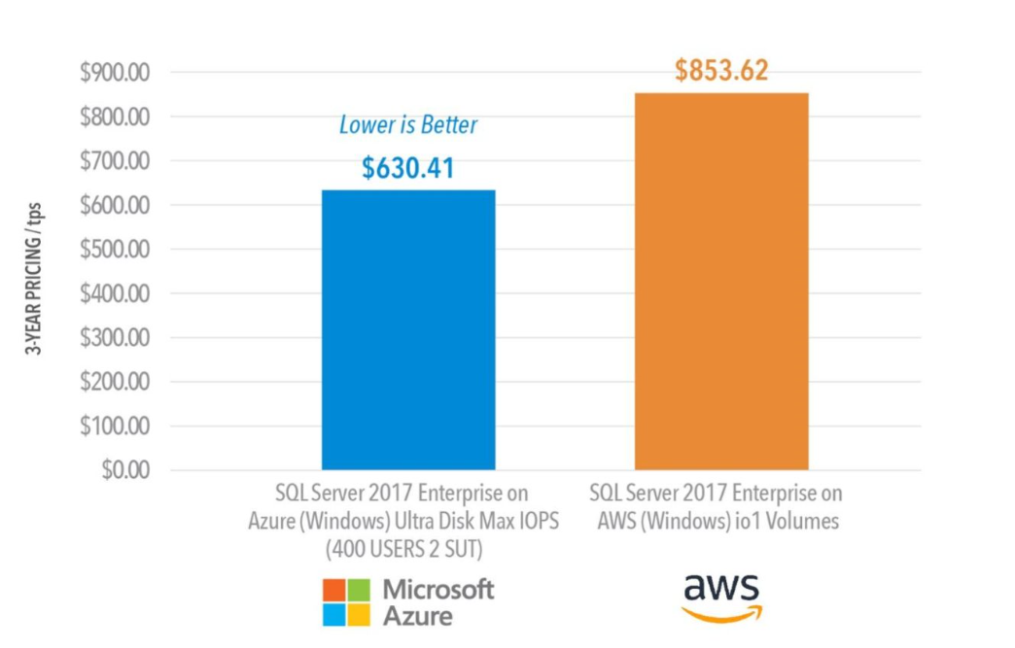
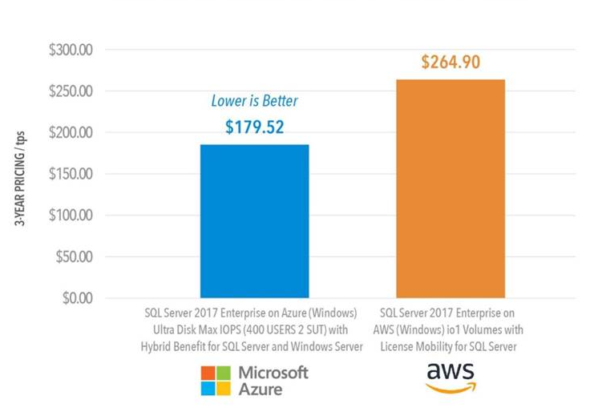
Benchmarks show Ultra Disk Azure SQL VMs deliver up to 32% savings
1st SQL IaaS Benchmark Report (December 2019)
Io1 vs. Ultra Disk price-performance comparison
Pay-as-you-go
io1 with license mobility vs Ultra Disk with Hybrid Benefit
26% less
32% less
Data sets derived from industry-recognized TPC-E Benchmark™
Simulated 400 concurrent users, unlimited pacing, 8 deg of parallelism, 5 test runs.
Results above were for the latest AMD VM series on Azure and AWS.
Performance and price-performance claims based on data from a study commissioned by Microsoft and conducted by GigaOm in October 2019. The study compared price performance between SQL Server 2017 Enterprise edition on Red Hat Enterprise Linux 7.4 in Azure E64s_v3 instance type with 4x P30 1TB Storage Pool data (Read Only Cache) + 1x P20 0.5TB log (No Cache) and the SQL Server 2017 Enterprise edition on Red Hat Enterprise Linux 7.4 in AWS EC2 r4.16xlarge instance type with 1x 4TB gp2 data + 1x 1TB gp2 log. Benchmark data is taken from a GigaOm Analytic Field Test derived from a recognized industry standard, TPC Benchmark™ E (TPC-E), and is based on a mixture of read-only and update intensive transactions that simulate activities found in complex OLTP application environments. Price-performance is calculated by GigaOm as the cost of running the cloud platform continuously for three years divided by transactions per second throughput. Prices are based on publicly available US pricing in West US for SQL Server on Azure Virtual Machines and Northern California for AWS EC2 as of October 2019. Price-performance results are based upon the configurations detailed in the GigaOm Analytic Field Test. Actual results and prices may vary based on configuration and region.

